Slide 1
Time Series Observations
JWST Master Class Melbourne 2022

Slide 2
Time Series Observations
30 min (including 15 min of “hands-on” exercises)

Slide 3
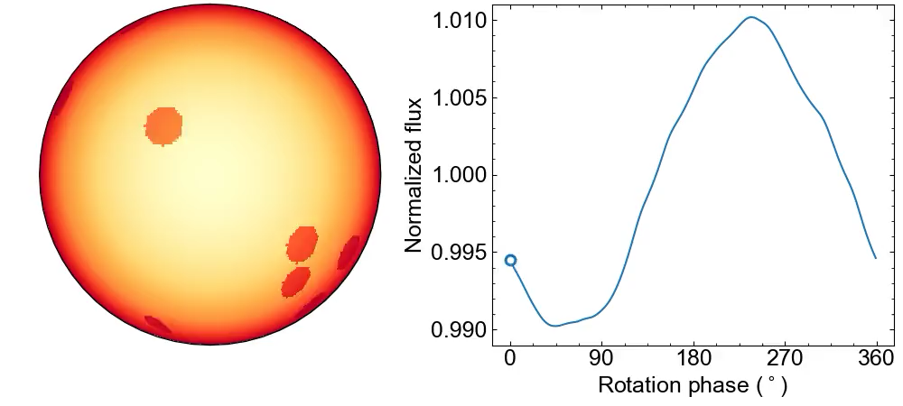
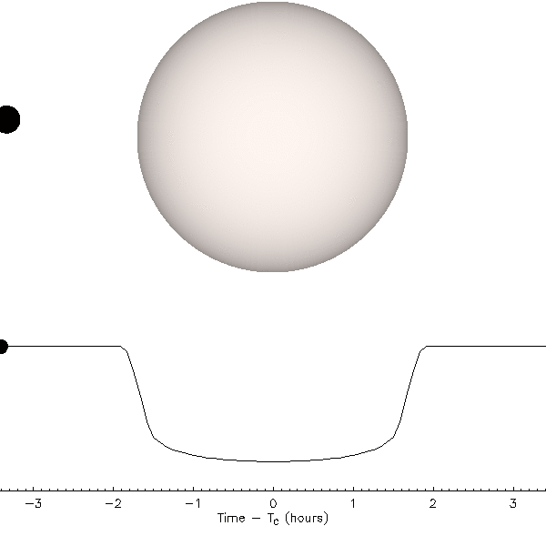
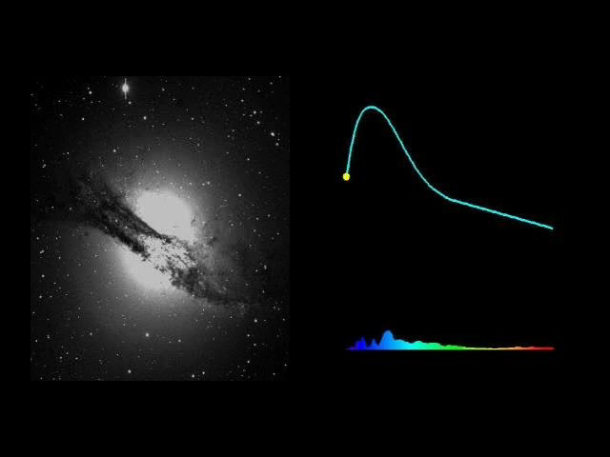
Time Series Observations (TSOs) – Examples
Stellar variability
Animation: Benjamin Rackham
Transiting exoplanets
Animation: Jason Eastman
Supernovae
Animation: N. Johnston/Supernova Cosmology Project

Slide 4
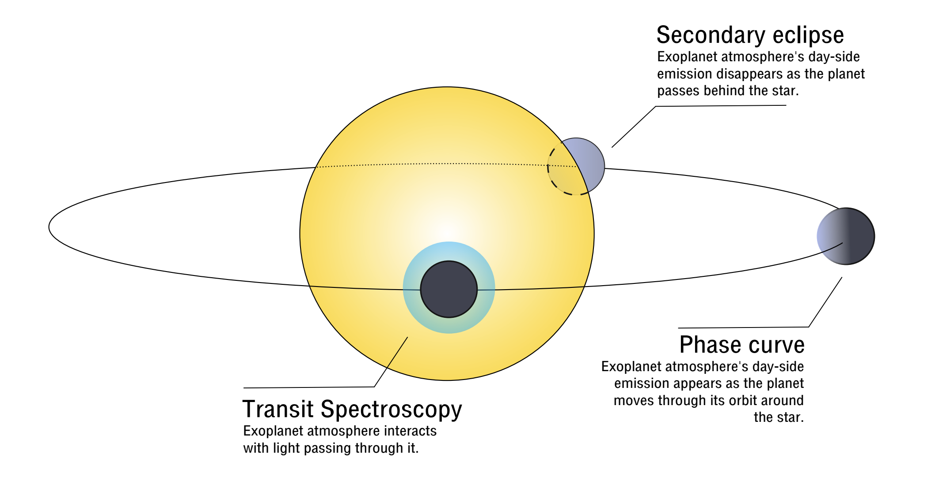
Example: Transiting Exoplanets as TSO Targets

Slide 5
What Is Special About TSOs?
Usually relative measurements aiming at high precision
Requires stability of observatory, instruments, and detectors; no dithers, exclusive use of instrument (no parallels), no detector reconfigurations / transitions while taking data
Supports long (>10,000 s) exposures with many (usually short) integrations
Allows for continuous/uninterrupted and stable observations of events from a few hours (e.g. exoplanet transits) to days (e.g. phase curves)
Exposures continue through High Gain Antenna moves
Often have stringent timing requirements on scheduling/start of observation (we want to see the transit / eclipse)
Needs special requirement(s) in APT
Might result in scheduling overhead (for observations with start window constrained to less than 1 hour) -> avoid if possible (increase baseline instead)
Notes:
TSOs require a stable platform – no dithers,parallels etc
Can go up to 2 days or even longer.... one long exposure many integrations, thousands
Antenna moves
Example of putting time in special requirements

Slide 6
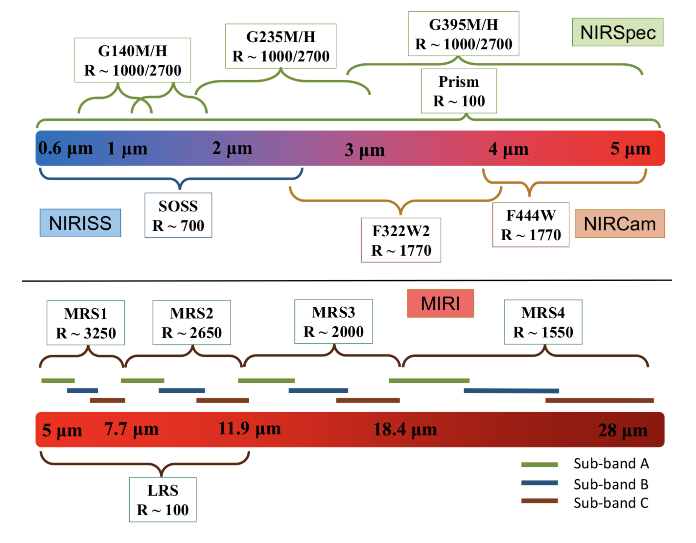
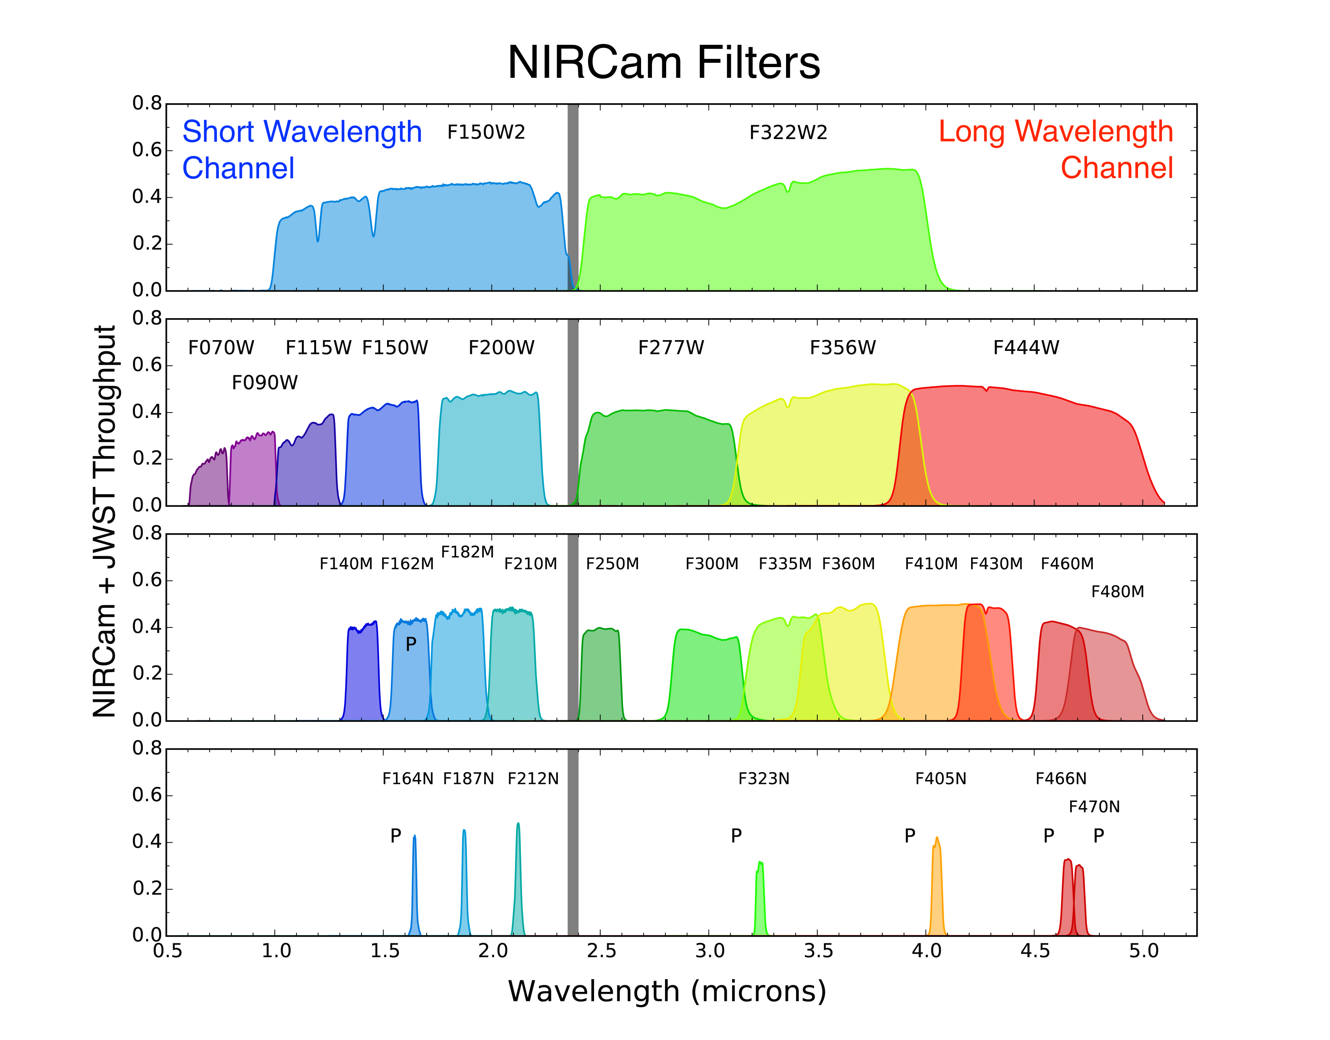
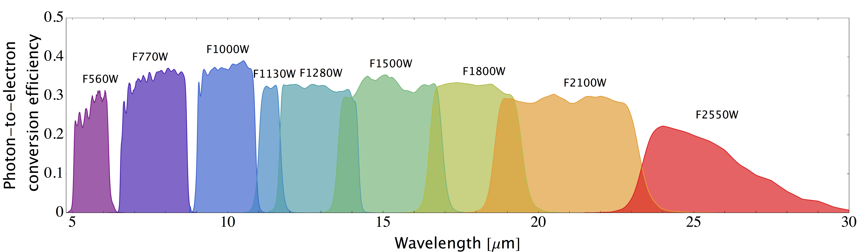
TSOs and JWST – Observing Modes
Spectroscopy
Photometry
Notes:
WHich modes support TSO? All of them
NIRSpec with prism or gratings
MIRI LRS 5-12 micron, MRS also

Slide 7
Selection of Instrument / Mode to Use
Desired (spectral) coverage/range
What (spectral) features are important for your science case?
Desired spectral resolution
SNR can be improved by spectrally binning data at cost of resolution
Source brightness / saturation limits
Other concerns / limitations
Slitless vs. “large” slit
Possible contamination from nearby sources (in particular for slitless observations)
Notes:
Coverage, resolution, then look at saturation limits, S/N for a transit
All but NIRSpec use slitless, nirspec has a large aperture

Slide 8
Preparing for Time Series Observations
As with most other observations there are three basic steps preparing TSOs:
Assess target observability given JWST LoS and target timing constraints. Check for possible target contamination when using slitless spectroscopy. Useful tools include: JWST GTVT, ExoCTK
Assess feasibility of observations and select the best observing mode/instrument for your science case. Useful tools include: PandExo, JWST ETC, ExoCTK
Create observations in APT. Remember to provide special timing requirements if needed (e.g. for transit observations):
Zero phase
Period
Phase range for start of observations
Notes:
Assess observability given time constraints
Pick best mde
Create in APT

Slide 9
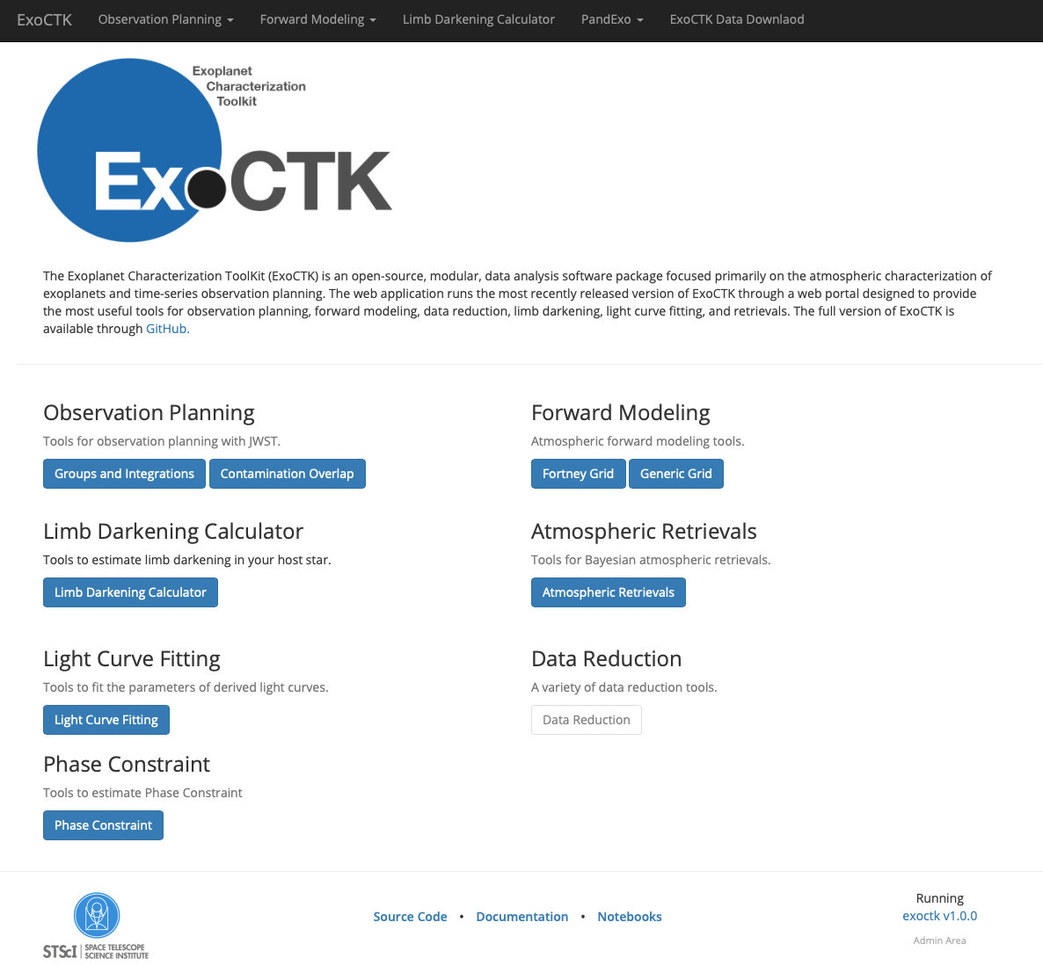
Exercise 1 – Observability using ExoCTK
Go to exoctk.stsci.edu
Under Observation Planning, select “Contamination Overlap” (yes, that’s right)
Notes:
ExoCTK is special suite for exoplanets for observation planning
Contamination overlap also gives visibility

Slide 10
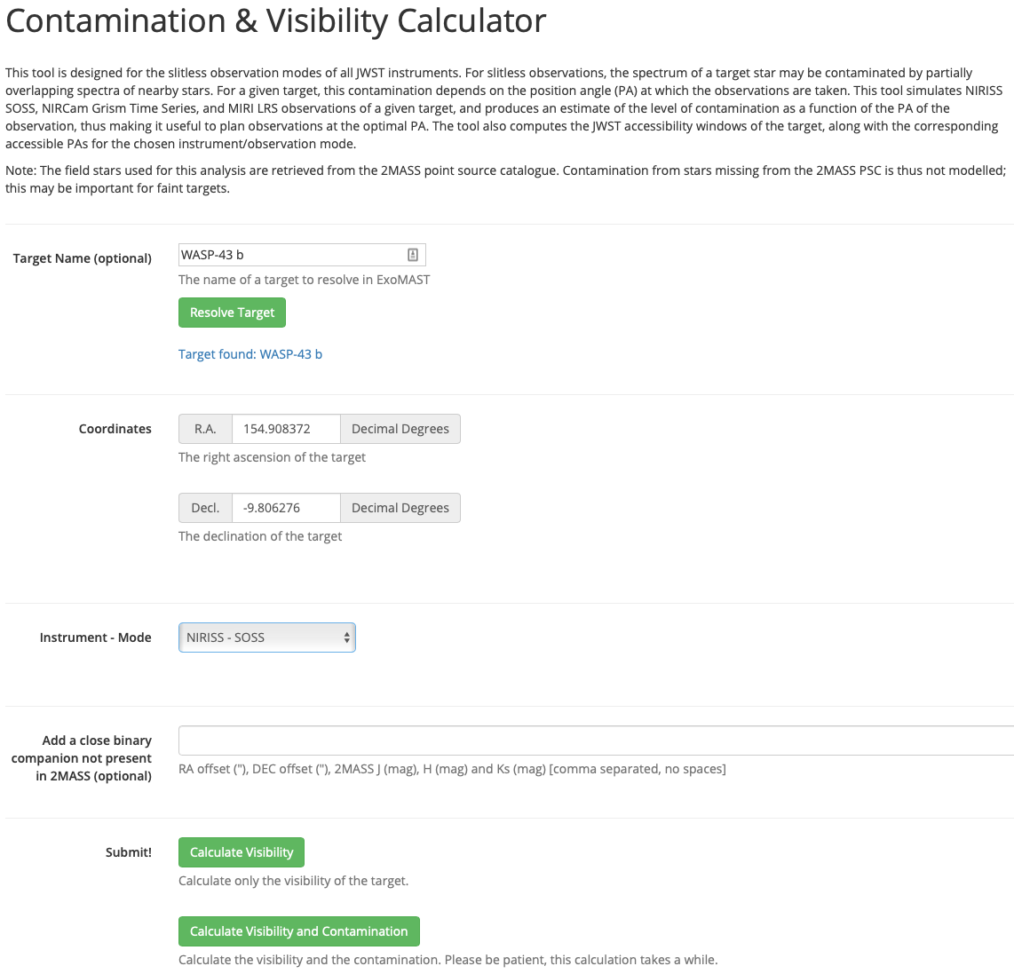
Exercise 1 – Observability using ExoCTK
Go to exoctk.stsci.edu
Under “Observation Planning”, select “Contamination Overlap” (yes, that’s right)
Type in target name to resolve or provide target coordinates
Select instrument (only affects reported PA)
Click “Calculate Visibility” or “Calculate Visibility and Contamination” (available for NIRISS SOSS and NIRCam Grism Spectroscopy only)

Slide 11
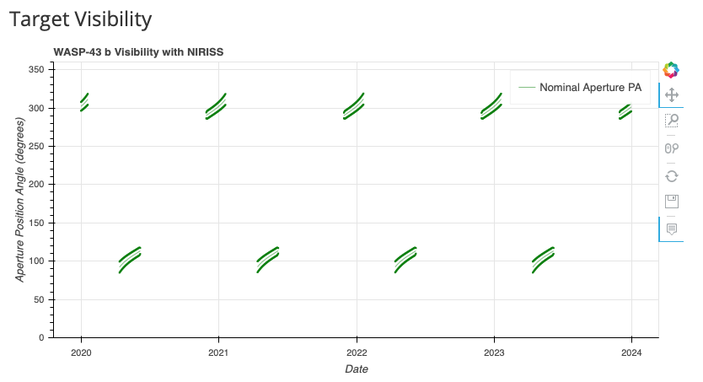
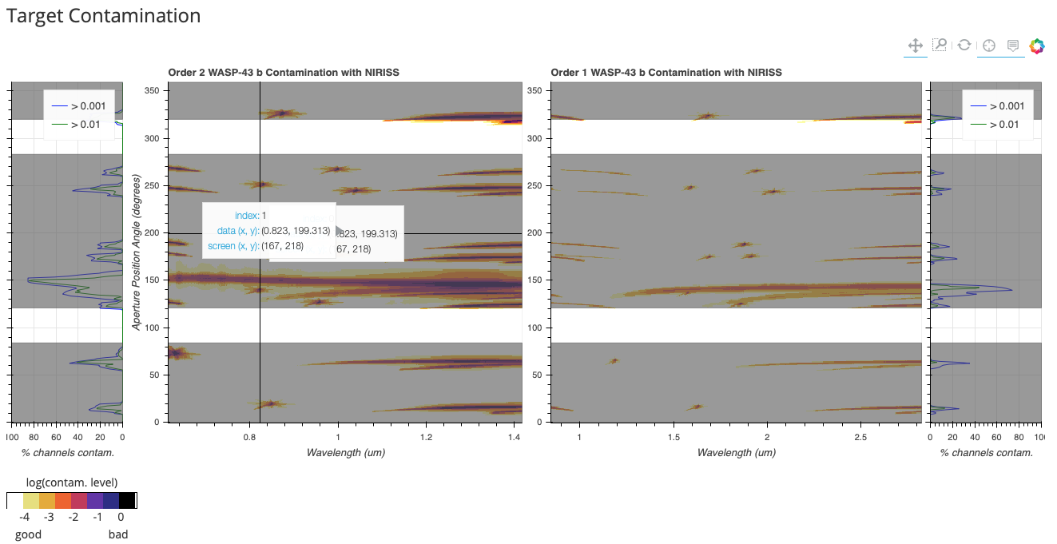
Exercise 1 – Observability using ExoCTK
Go to exoctk.stsci.edu
Under “Observation Planning”, select “Contamination Overlap” (yes, that’s right)
Type in target name to resolve or provide target coordinates
Select instrument
Click “Calculate Visibility” or “Calculate Visibility and Contamination”
Inspect target visibility (and contamination if applicable)

Slide 12
Exercise 2 – Exposure Settings and More
Use JWST ETC and/or ExoCTK and/or PandExo to estimate best exposure parameters
How long should your transit observations be? According to JDox:
This might seem long, but accounts for possible detector transients at beginning of exposure(s), uncertainty in transit times, etc. Justify if you go shorter (or even longer)
Do not go below 2 T₁₄ = ½ T₁₄ + T₁₄ + ½ T₁₄ (unless you have a very compelling reason to do so)
Keep in mind phase start/end special requirement; recommendation is to keep phase window at least 1 hour wide, in order to prevent direct scheduling overhead (of 1 h)
0.75 + max(1 hr, T₁₄/2)
max(1 hr, T₁₄/2) + 1 hr
T₁₄

Slide 13
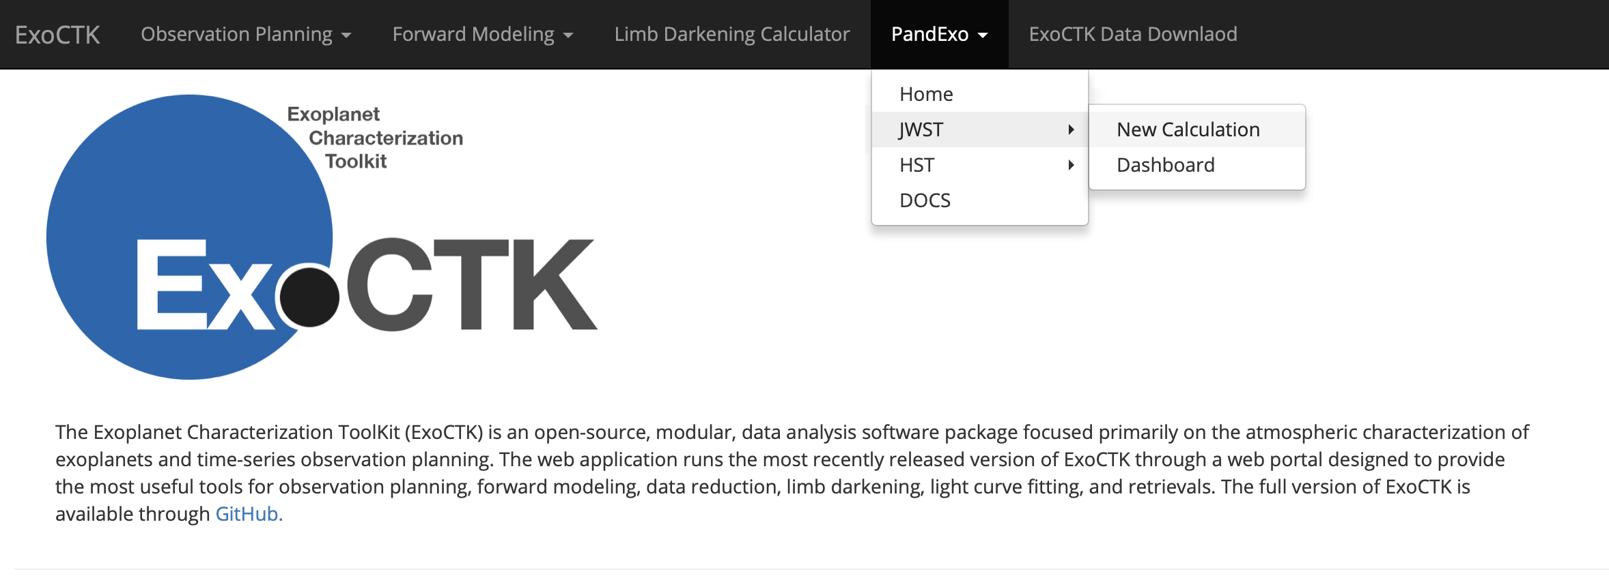
Exercise 2 – Exposure Settings and More
Go to exoctk.stsci.edu and select “PandExo” from the top menu bar
Select “JWST”
Select “New Calculation”

Slide 14
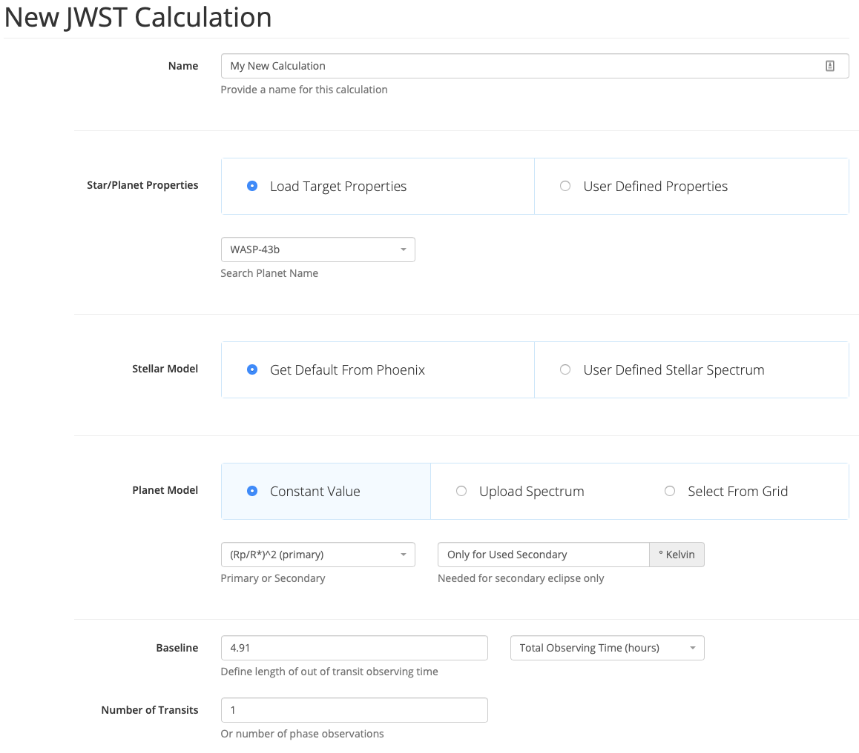
Exercise 2 – Exposure Settings and More
Go to exoctk.stsci.edu and select “PandExo” from the top menu bar
Select “JWST”
Select “New Calculation”
Fill out values for star and planet
properties
Can use defaults for many known systems
Fill out ”Baseline” duration number
of observed transits
Remember recommendation for
total observation duration here:
0.75 h + max(1 h, T₁₄/2) + T₁₄ + max(1 h, T₁₄/2) + 1 h
= 4.91 h

Slide 15
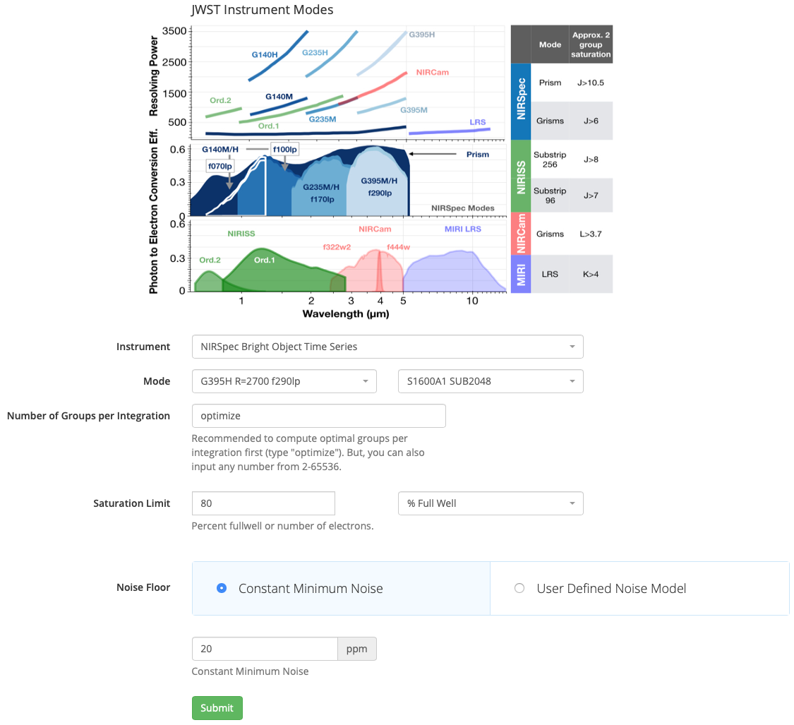
Exercise 2 – Exposure Settings and More
Fill out instrument setup and assumed
noise model
Use “optimize” for # of groups if you want PandExo to estimate for you
Specify target counts/charge (typically 80% full well for NIR and 50% for MIR instrument(s))
Click “Submit” and simulation will run
Click on “eye” symbol to expect
results
Notes:
Instrument wavelength coverage and resolution handy reference
NIRspec example, select the grating/filter you want
Subarray – jdox look (frame times etc)
Here you can just tell it I want to go to 80% full well, give me the number of groups
Flat noise (we don't have a model)

Slide 16
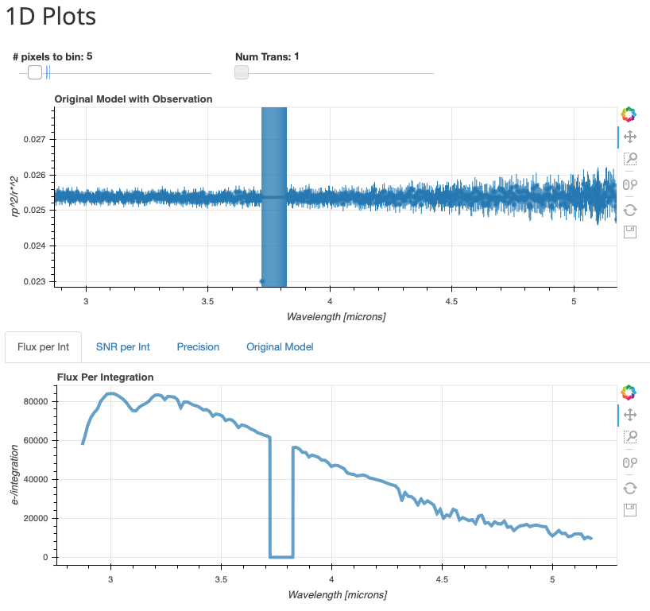
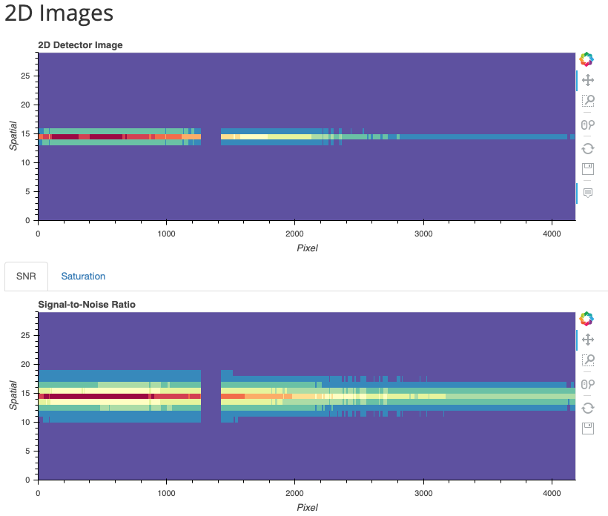
Exercise 2 – Exposure Settings and More
Inspect simulated results

Slide 17
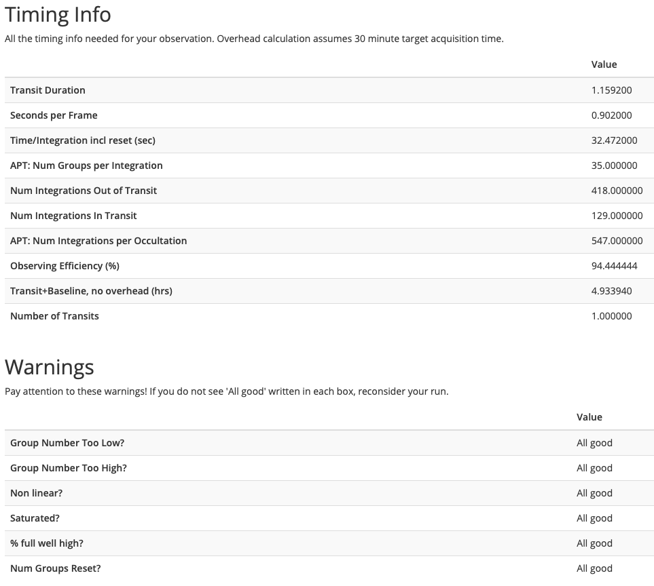
Exercise 2 – Exposure Settings and More
“Timing Info” is useful to set exposure parameters (groups & integrations for selected subarray)
Use in APT
Inspect Warnings
“All good”: no issues with the simulated observation
Otherwise assess if change of mode and/or instrument is warranted
Notes:
Summary table with the transit durations, max groups before hitting the saturation limit
All the numbers for APT
Warnings... (source is too bright for this mode eg)

Slide 18
Putting It Into APT
Input target(s) and select chosen Instrument/Observing Template
Target Acquisition:
Recommended to do TA (known and consistent source placement)
Some targets will be too bright to acquire directly (in particular for NIRSpec); APT allows user to select nearby TA reference target
Estimate TA parameters using the ETC (like for any other TA)
Exposure setup / duration / number of groups per integration / etc.:
Use results from JWST ETC or PandExo
Special requirements:
Time Series Observation (implicit in some templates)
No Parallels
Phase (Phase range, Period, Zero phase)
Keep in mind direct scheduling overhead of 1 hour if the specified phase range corresponds to less than 1 hour
Can also the ExoCTK phase constraint calculator (does not yet follow recommended baseline)
Notes:
Some special things for TSOs – longer than 10000s , add TSO special requirement
No parallels
Start window is given in phases; go an hour before
Exoctk has a phase calculator

Slide 19
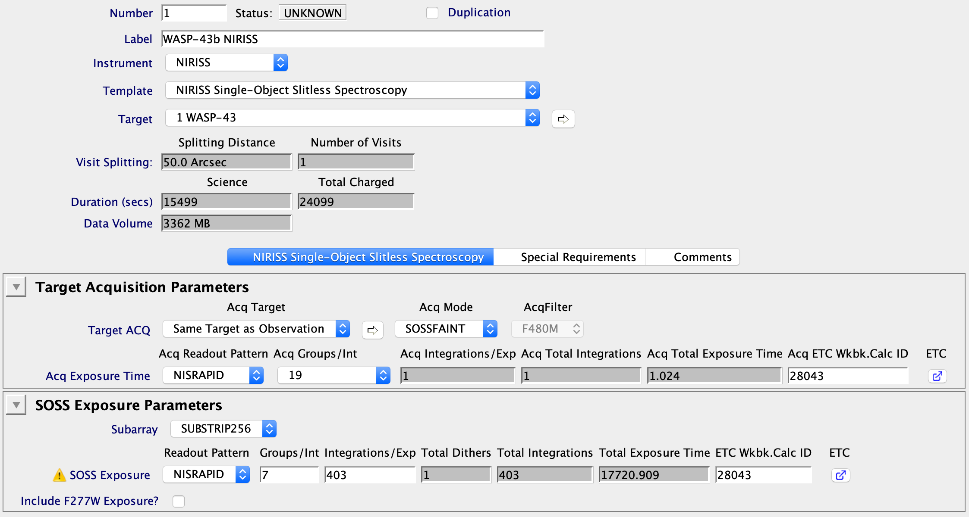
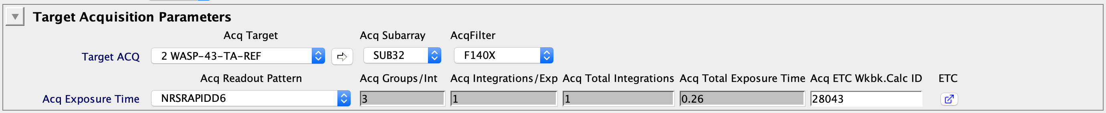
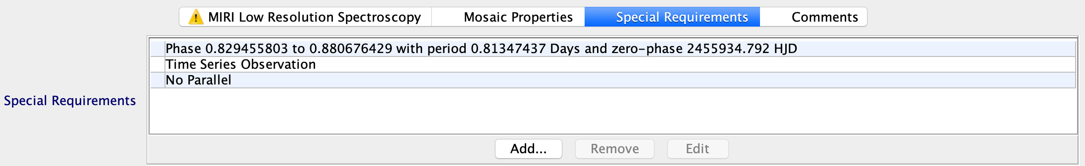
Putting It Into APT
NIRISS example
NIRSpec TA on
reference target
Special requirements on timing
Notes:
TA recommended even for slitless, usually on science target

Slide 20
Summary & Reminders
Assess target observability given JWST and target timing constraints. Useful tools include: JWST GTVT, ExoCTK
Select the best observing mode / instrument for your science case. Useful tools include: PandExo, JWST ETC, ExoCTK
Create observations in APT. Remember to provide special timing requirements if needed (e.g. for transit observations)
Always check the JWST Documentation:
jwst-docs.stsci.edu
(includes the call for proposals for cycle1
and many use cases and examples)
Questions? Cannot find the answer? Contact the JWST Help Desk:
jwsthelp.stsci.edu

